Slide 1
NextGen ATC Next Generation Air Traffic Control Display System
Bespectacled Builders
Elena Corpus
Lucas Iverson

Slide 2
NextGen Display System Project Overview
Per the FAA:
“Through our modernization efforts, the FAA is creating new interconnected systems that fundamentally change and improve how National Airspace System (NAS) users see, navigate, and communicate.”
Our focus is on the UX for the Air Traffic Controllers
Specifically via radar scopes
Incorporate TCAS technology
Enhanced information and instruction capabilities with new interface

Slide 3
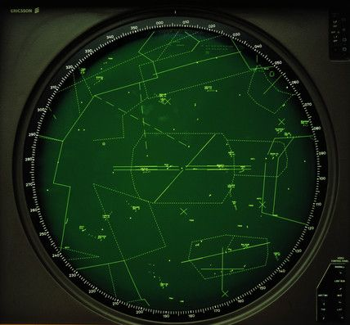
Outdated Radar Example

Slide 4
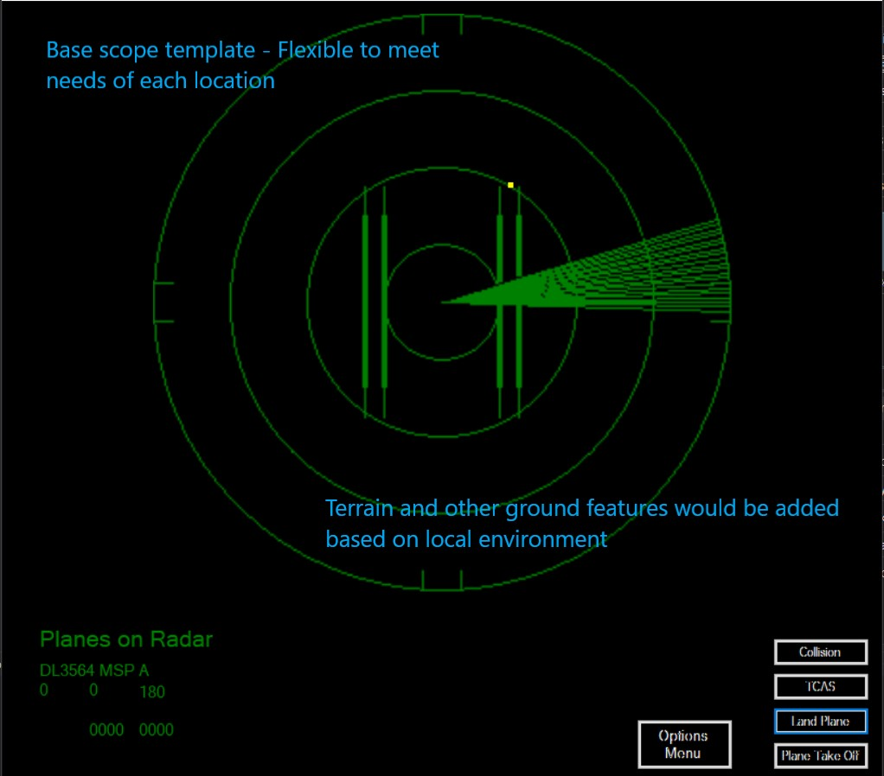
New Base Scope

Slide 5

Decisions
General Design?
Future changes?
Who is main focus?
How complex to build initial demo?

Slide 6
Decisions
Keep scope simple, yet flexible
Touchscreen
Primary user –
Air Traffic Controller
Initial demo will be base scope – local needs will be determined and added as project develops

Slide 7
Methodology
Build UML diagrams
Account for appropriate stakeholders
Apply proper principles to project development
Adhere to UI design guidelines

Slide 8
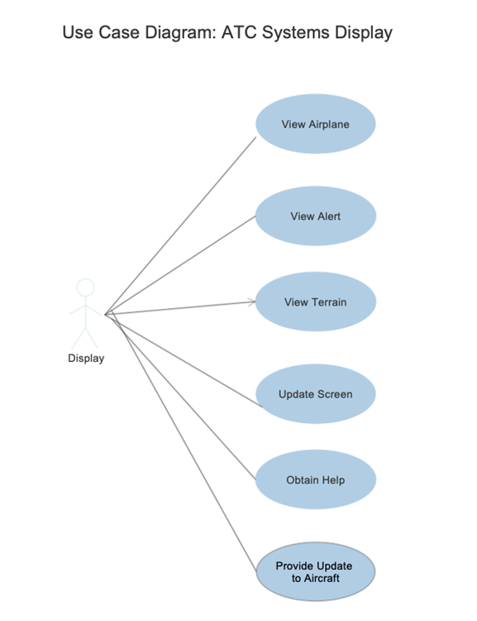
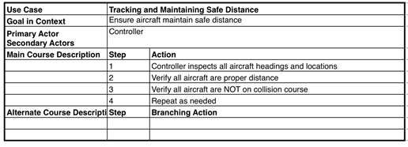
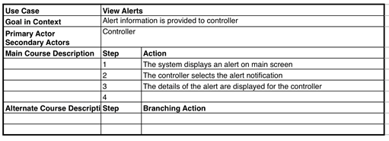
Use Case Diagram / Use Case examples

Slide 9
Issues encountered
Primary issues encountered were related to programming

Slide 10
Issues Encountered
Programming
Unknown variables

Slide 11
And now… Our demo:

